Slide 1
LLME Meeting 9 October 2019

Slide 2
Agenda
2.00pm Welcome & Introduction
2.10pm Update for 2019/20
2.20pm A GCSE Problem
2.30pm Break out
4pm Evaluation – Dates of next meetings
29 January 2020
10 June 2020

Slide 3
LLME – What is this forum for?
LLME - Local Leaders of Mathematics Education
SLEs, PD Leads, Primary Mastery Specialists,
Secondary Mastery Specialists, Local Maths Consultants
Remit - Facilitate system wide improvement by extending leadership skills, deepening understanding of great Mathematics teaching and discussion of other issues relating to Mathematics.
Focus Points:
Mastery
Enhancing Leadership Capacity
Steering National Mathematics Hub Agenda

Slide 4
Hub Personnel
David Grant – Maths Hub Lead (Level 3 Lead)
Helen Mason-Smith – Project Manager
Kirsty Pettinger – Teaching for Mastery Lead (Primary)
Irina Tolchenova - Teaching for Mastery Lead (Secondary)
Sally Barker – Assistant Teaching for Mastery Lead (Primary)
Zoe Akers – Assistant Teaching for Mastery Lead (Primary)
Lucy Froude – Outreach Administrator (Teaching for Mastery)
david.grant@matrixmathshub.co.uk
helen.mason-smith@matrixmathshub.co.uk

Slide 5
Maths Hub Update
New Essex Hub – will be based in St Thomas More’s Catholic Primary School, Colchester
2019-20 : No Change (Transition in the background)
2020-21 : New Hub up and running

Slide 6
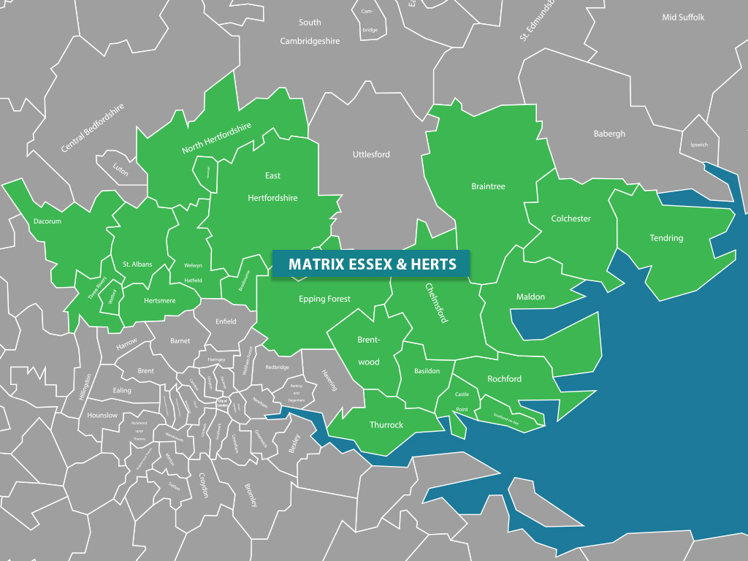
Maths Hub Update

Slide 7
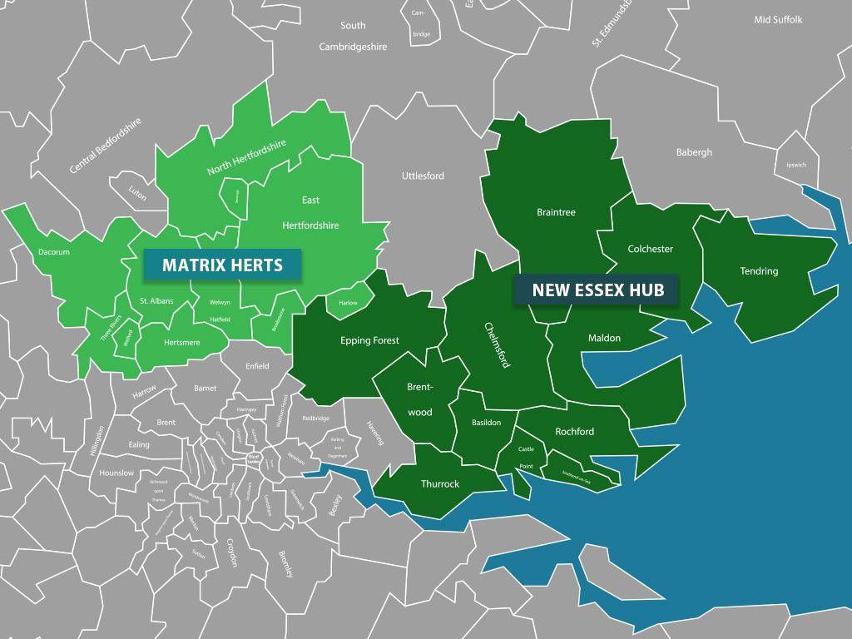
Maths Hub Update

Slide 8
Essex Hub Personnel
Natalie Banthorpe – Maths Hub Lead
Leona Saker – Teaching for Mastery Lead (Primary)
TBC - Teaching for Mastery Lead (Secondary)

Slide 9
Strategic Priorities 2019/20
Recruit: 60 primary schools to our Hertfordshire TRGs,
60 to our Essex TRGs for September 2020
Recruit more Secondary schools and Mastery specialists in Hertfordshire
Recruit wider geographical engagement within Hertfordshire
Continue to build our LLME community to 50 people in Essex and 50 people in Herts

Slide 10

HOW CAN YOU SUPPORT US?
Nominate a LLME for our community
lucy.froude@matrixmathshub.co.uk
SLEs (Maths)
PD Leads
Primary Mastery Specialist
Secondary Mastery Specialist
Maths Advisors
Lead practitioners
etc.

Slide 11
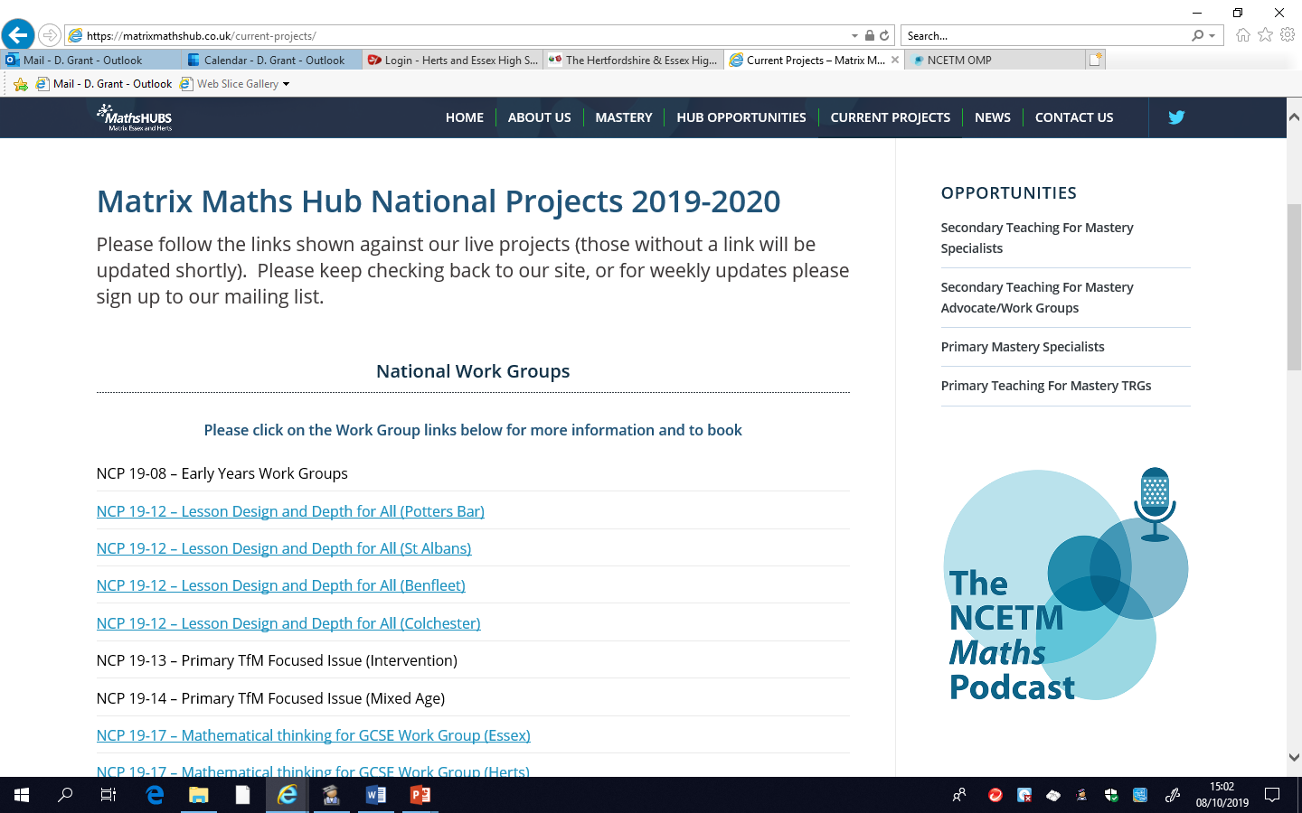
Opportunities

Slide 12
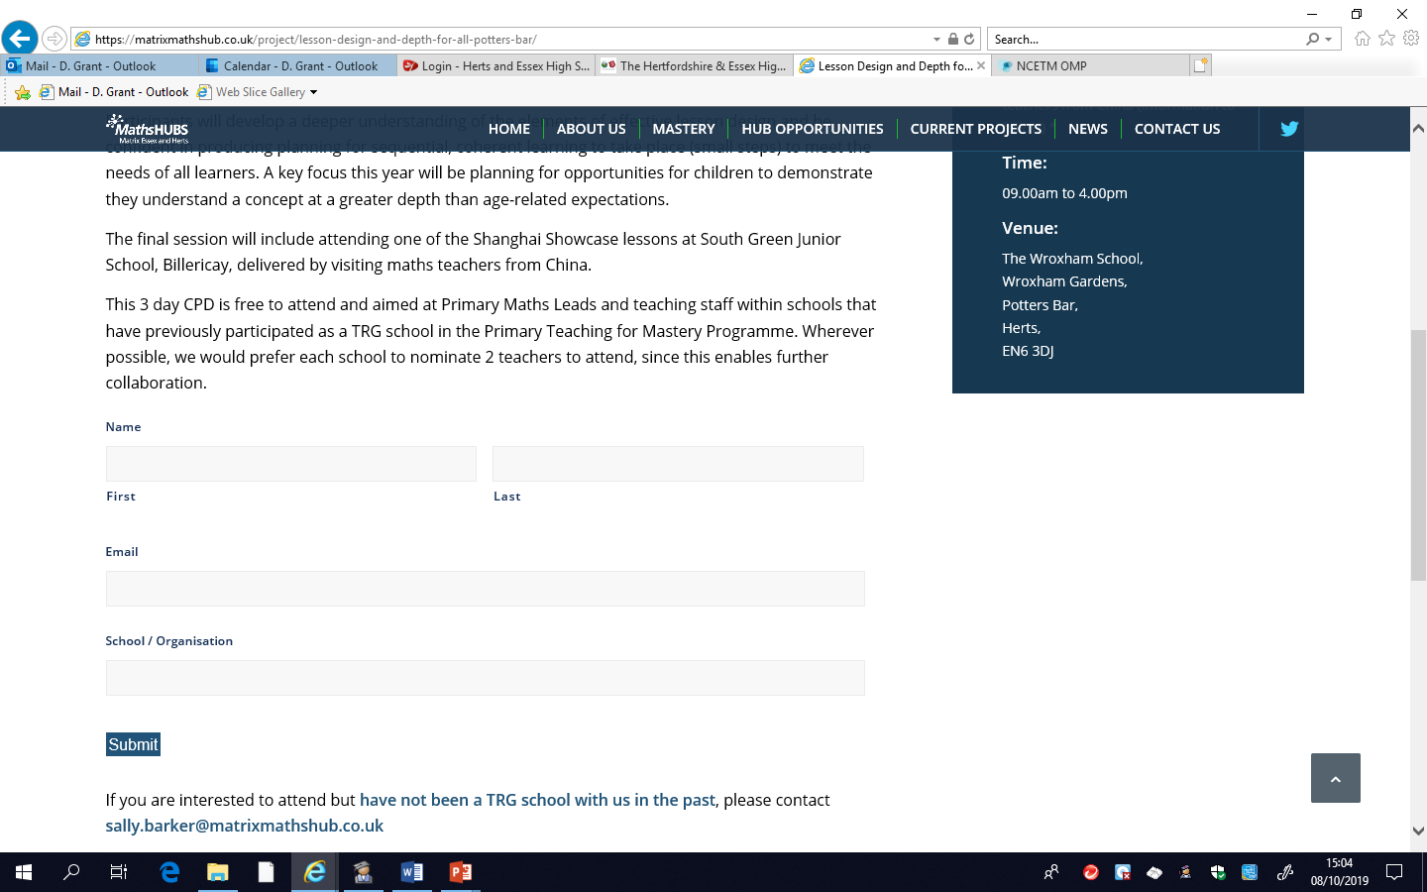
Opportunities

Slide 13

Opportunities
Australia Exchange / Hosting

Slide 14
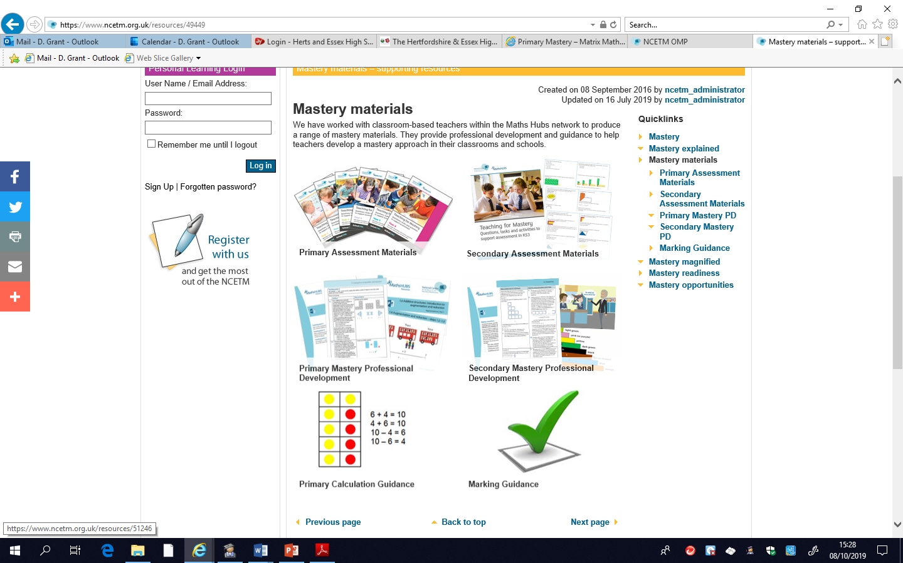
Resources

Slide 15
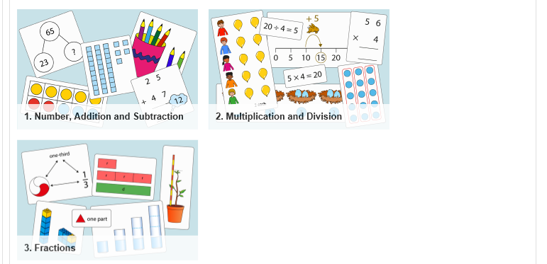
Primary PD Resources

Slide 16
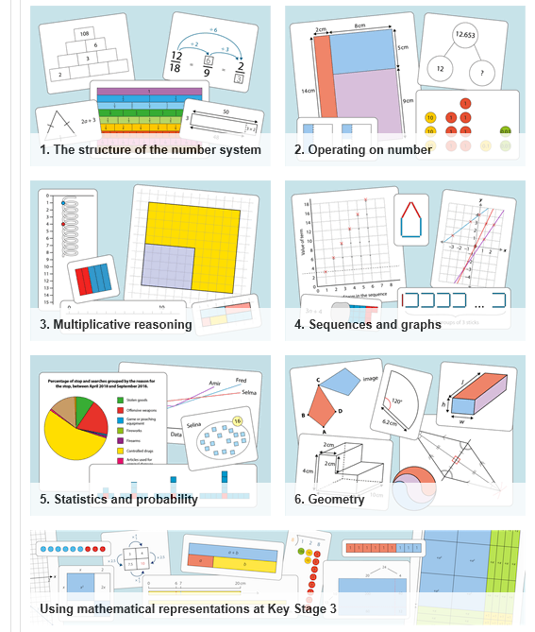
Secondary PD Resources

Slide 17
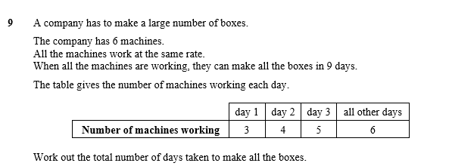
A GCSE PROBLEM

Slide 18
A GCSE PROBLEM

Slide 19
NCETM Strategic Priorities 2019/20 (final)
Embed teaching for mastery approaches in primary schools so that all pupils develop the deep knowledge and understanding they need to be fully prepared for the secondary mathematics curriculum.
Develop and begin to embed teaching for mastery in secondary schools, while also supporting schools and colleges to address the challenges of teaching GCSE Mathematics, so that all pupils are prepared for progression to post-16 education.
Provide support for participating schools to implement teaching for mastery with fidelity, consistency and to a high quality encouraging the effective use of high quality resources.
Ensure the training and effective development of local leaders of maths education through national programmes and local professional communities.
Develop the knowledge and practice of Early Years Foundation Stage practitioners to ensure that all children develop a secure foundation in mathematics so that they are ready for teaching for mastery in Key Stage 1.
Support the effective recruitment, preparation and development of new teachers of mathematics and other mathematics classroom practitioners, working in partnership with Initial Teacher Training (ITT), Subject Knowledge Enhancement (SKE), and other, providers, whenever possible.

Slide 20
Great Mathematics Lessons
What elements make for a successful Mathematics Lesson? What does good learning look like? Try and note what you expect to see teachers doing and students doing.
Discuss in pairs and list the ten most important elements.

Slide 21
NEW OFSTED FRAMEWORK
Thinking about your response to the previous task, highlight the OFSTED descriptor for QUALITY OF EDUCATION where you think there is overlap. Discuss the outcomes.

Slide 22
Future Meeting Focus
The LLME forum is for us to discuss items of importance to Mathematics delivery across Hertfordshire and Essex. What might you like to discuss or see discussed in future meetings?

Slide 23
Supporting the Hub
SECONDARY ASSISTANCE
SLE Support

Slide 24
LLME Forum Future Dates
9 October 2019 2pm to 4pm
29 January 2020 2pm to 4pm
10 June 2020 2pm to 4pm

