Slide 1
ORACY AND MASTERY: The cause and the consequence
Dr James Mannion, FCCT
Associate, Oracy Cambridge
Director, Rethinking Education
Bespoke Programmes Leader, UCL Centre for Educational Leadership
james@rethinking-ed.org @rethinking_ed

Slide 2
Aims for today
Evidence for oracy
Oracy in practice:
The Oracy Skills Framework
Talk goals
Talk rules
Oracy and transition: the ‘Who am I’ project
Oracy and mastery

Slide 3
Aims for today
Evidence for oracy
Oracy in practice:
The Oracy Skills Framework
Talk goals
Talk rules
Oracy and transition: the ‘Who am I’ project
Oracy and mastery

Slide 5
 | Area of impact
Cognitive outcomes | Improved attainment in English, Maths, Science… Improved literacy skills Improved verbal and non-verbal reasoning Enhanced outcomes for pupils with SEND Enhanced outcomes for bilingual pupils
Social and emotional outcomes | Self-esteem / self-confidence Engagement and on-task focus Social development / peer interactions Emotional intelligence Greater empathy Ability to handle stress
Life outcomes | Overcoming social disadvantage Fewer exclusions, less juvenile offending Improved future earnings

Slide 6
The Learning Skills curriculum
Timetabled lessons → Y7 – 5 lessons / week → Y8 – 3 lessons / week → Y9 – 5 lessons / fortnight
Embedded across the curriculum → Shared pedagogical strategies → Joined up approach to CPD
Strategies for transfer → Transfer out (of Learning Skills) → Transfer in (to subject learning)

Slide 7
The Learning Skills curriculum
Timetabled lessons → Y7 – 5 lessons / week → Y8 – 3 lessons / week → Y9 – 5 lessons / fortnight
Embedded across the curriculum → Shared pedagogical strategies → Joined up approach to CPD
Strategies for transfer → Transfer out (of Learning Skills) → Transfer in (to subject learning)
A ‘complex intervention’ - 3 key concepts: metacognition, self-regulation, oracy
Shared language of learning
Philosophy for children
Presentational talk
Structured debates
Talk goals
Talk rules…
8-year, mixed-methods evaluation
4 cohorts of students, Y7 → Y11
1 control cohort
3 Learning Skills cohorts

Slide 8
Gains in academic learning: 3-year analysis

Slide 9
Closing the gap: 3-year analysis
92% reduction

Slide 10
Gains in academic learning: GCSE (5-year) analysis

Slide 11
Closing the gap: GCSE (5-year) analysis
>65% reduction

Slide 12
Student interviews
’Learning Skills has helped me learn better in subjects because I’ve got a lot more confident.’
‘The thing I am most proud of this year is the “Who am I” project because I learnt how to stand up in front of a big group of people confidently.’
‘The thing I am most proud of from my first year at Sea View is confidence because I’m a lot smarter [and] I can speak up more.’
‘Now I have the courage to speak in all of my classes.’
‘Learning Skills has helped me so much. It’s taught me to stand up for myself and what I want to say is important. I have found my voice and I think more harder than I ever have in using the right language.’

Slide 13
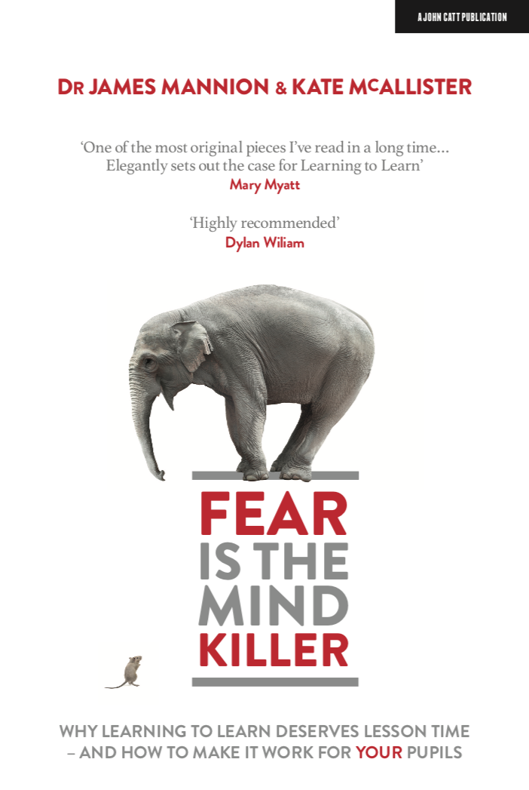

Slide 14
Aims for today
Evidence for oracy
Oracy in practice:
The Oracy Skills Framework
Talk goals
Talk rules
Oracy and transition: the ‘Who am I’ project
Oracy and mastery

Slide 15
The Oracy Skills Framework

Slide 16
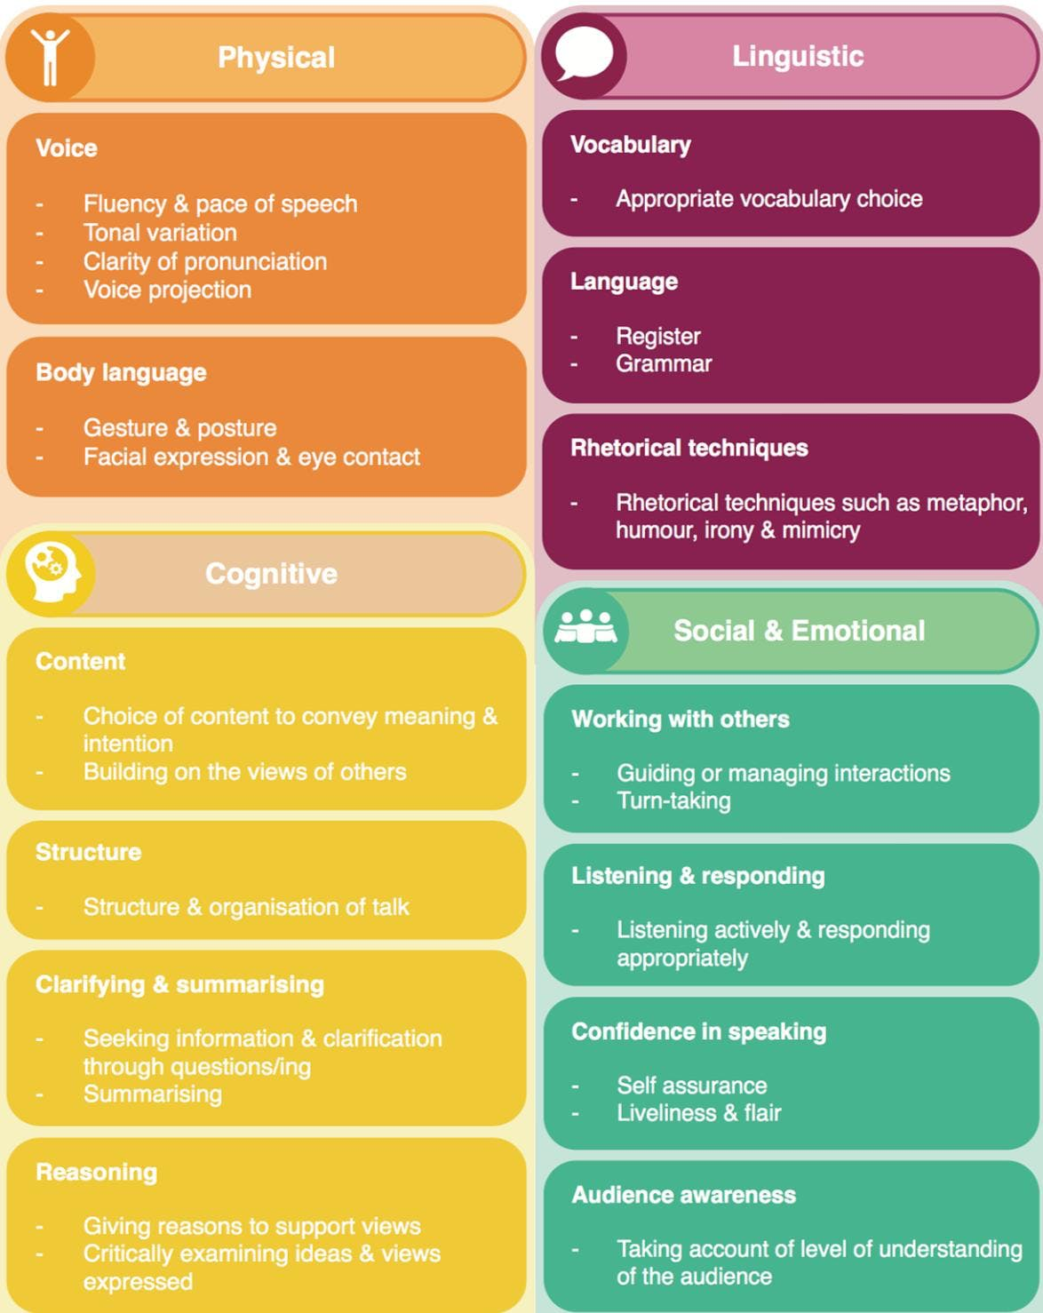
Talk goals
Children should choose, ideally from a list - eg:
Talk rules - each child picks one to focus on
A simplified version of the Oracy Skills Framework →
They don’t need to be overly specific, eg
I will plan what I want to say before I start speaking
I will try to speak less
I will give reasons for my thinking
I will make notes to help me actively listen
Bookend the discussion, eg:
Share goals at the start (e.g. in pairs)
Refer back to them at the end

Slide 17
Talk rules
Three kinds of talk:
Disputational
Cumulative
Exploratory

Slide 18
Talk rules
Disputational talk:
Lot of disagreement – pupils just make their own decisions
Few attempts to pool resources, or offer constructive criticism
Lot of interactions of the 'Yes it is! – No it's not!' kind
Atmosphere is competitive rather than co-operative

Slide 19
Talk rules
Cumulative talk:
Pupils simply accept and agree with what others say
Pupils wait until someone else stops talking so they can share their own idea
The talk ‘stacks up’ – pupils do use talk to share knowledge, but they do so in an uncritical way
Pupils repeat and may elaborate each other's ideas, but don't evaluate them carefully

Slide 20
Talk rules
Exploratory talk:
Everyone is encouraged to contribute
Everyone listens actively
Pupils share all relevant information
Focus on reasoning – use of the word ‘because’
Contributions build on what has gone before
Pupils ask questions of one other to seek clarity
Ideas may be challenged – but pupils address the point, not the person
The group seeks agreement for joint decisions

Slide 21
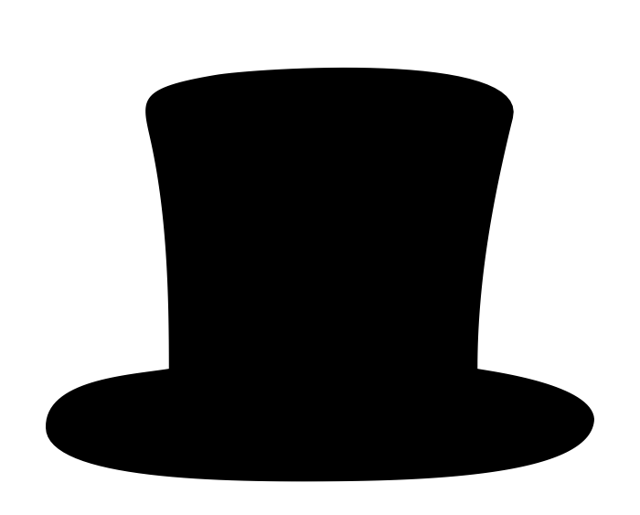
Talk rules
The hat method:
Two scraps of paper each
“When group talk goes well…”
Place into hat (→ anonymity)
Repeat for “When group talk goes badly…”
Compile into two lists
Place them side by side
Distil into 〜7 ground rules

Slide 22
Talk rules
Examples:
We will talk together to think about what to do.
We will share what we know with each other.
We will ask everyone to say what they think.
Everyone will listen carefully to others and consider what we hear.
We will give reasons for what we say.
We will decide what to do only when everyone has said all they want.
We will try to agree about what we think

Slide 23
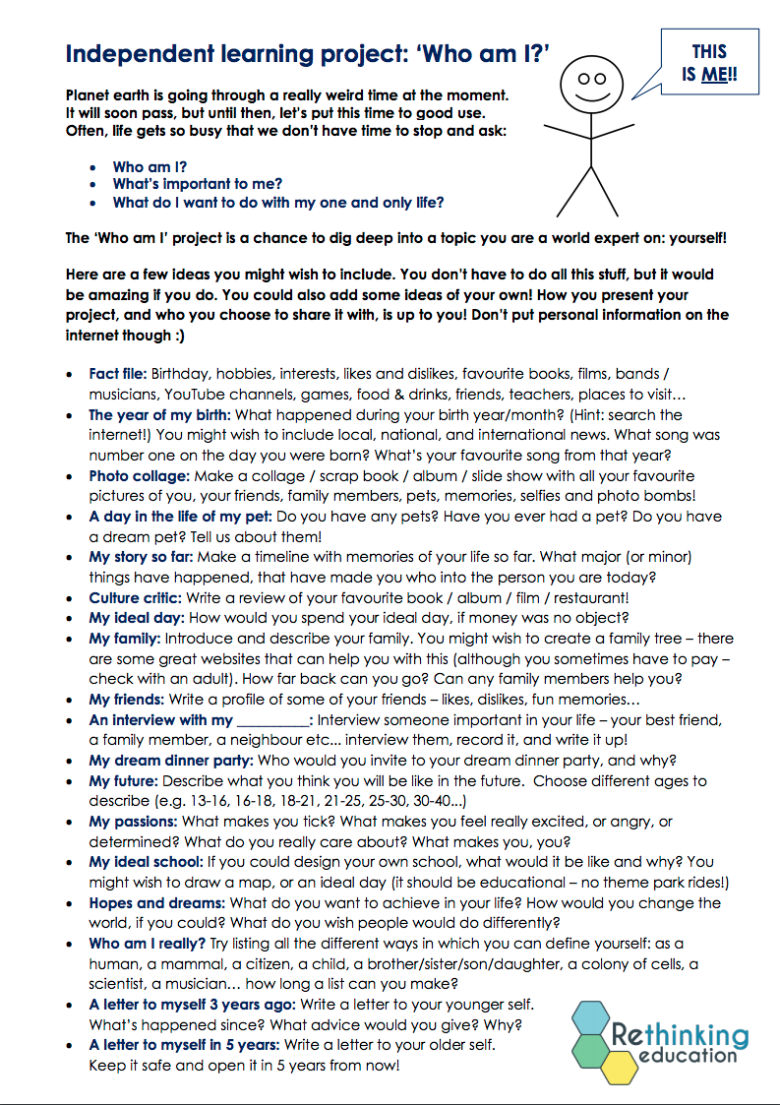
Oracy and transition: the ‘who am I?’ project
Fact file
Photo collage
My ideal day
An interview with my _____
My passions
My ideal school
Hopes and dreams
A letter to my future self
Present to the class
End of year 6
Start of year 7
→ tinyurl.com/whoamiHERTS

Slide 24
Oracy and transition: the ‘who am I?’ project
Fact file
Photo collage
My ideal day
An interview with my _____
My passions
My ideal school
Hopes and dreams
A letter to my future self
Present to the class
End of year 6
Start of year 7
‘The thing I am most proud of this year is the “Who am I” project because I learnt how to stand up in front of a big group of people confidently.’
→ tinyurl.com/whoamiHERTS

Slide 25
ORACY AND MASTERY: The cause and the consequence

Slide 26
ORACY AND MASTERY: The cause and the consequence
Mastery of oracy is a worthwhile educational goal in itself
Speaking and listening provide us with a starting point and a vehicle for gaining mastery in other domains
Articulating what you know / are unsure about
Asking questions
Giving and receiving feedback
Oracy is how we demonstrate mastery
Of oracy itself
Within other domains

Slide 27
ORACY AND MASTERY: The cause and the consequence
Dr James Mannion, FCCT
Associate, Oracy Cambridge
Director, Rethinking Education
Bespoke Programmes Leader, UCL Centre for Educational Leadership
james@rethinking-ed.org @rethinking_ed

